Slide 1

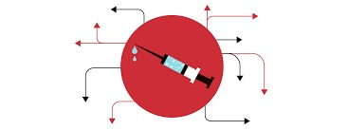
CMR COLLEGE OF ENGINEERING & TECHNOLOGY Kandlakoya, Medchal, Hyderabad - 501401 Department of Computer Science and Engineering
VACCINE HANDLING SYSTEM
Under esteemed guidance of
Ms.Preety Singh
19H51A0538 - D.KEERTHI
19H51A0539 - E.SANJUPRIYA
19H51A0544 - K.PAVAN

Slide 2
ABSTRACT
As we all know COVID-19 phase-2 is drastically effecting the people with its effect compared to last year. so, Now it is our responsibility to stop the spread of this COVID-19 by decreasing the people in locality and maintaining the social distancing and few other requirements. (AREA/LOCALITITIES: Tadband, Bowenpally, amberpet, chaitanyapuri, Nampally).So, we have come up with an idea of 'VACCINE HANDLING SYSTEM' where this project will help the people or admins in the locality who is managing the vaccines of COVID-19 by decreasing the people in vaccination center by speed data entry and smart working and we are using C++ file coding language in design of code. To handle our project we are using code blocks platform and to handle the vaccine data we using C++ file handling system environment.Hence we think that our project will be helpful at this present scenario and decreases the COVID-19 spread.

Slide 3
OBJECTIVE
The main objective of this project is to provide speed data entry in the vaccine centers there by, decreasing the crowd at vaccine center and making the work of the vaccinators/medical staff more easier and efficient way.
makes work easy
efficient to use

Slide 4
INTRODUCTION
It all started in the year 2020.On March 11, 2020 the World Health Organization declared that COVID-19 was a global pandemic, indicating significant global spread of an infectious disease (World Health Organization, 2020). At that point, there were 118,000 confirmed cases of the coronavirus in 110 countries.
we all know that the world had faced a tough time during the corona days.As the deaths rose from the virus that had no known treatment or vaccine countries shut their borders, banned travel to other countries and began to issue orders for their citizens to stay at home,with no gatherings of more than 10 individuals. After efforts of our Doctors we got vaccine for corona,as a responsible citizen we need to get vaccinated ourselves.
we observed our problem in the vaccine centersof tadband, nampally, amberpet, chaitanyapuri. so we came up with an idea of VACCINE HANDLING. Where the related data is stored virtually.

Slide 5
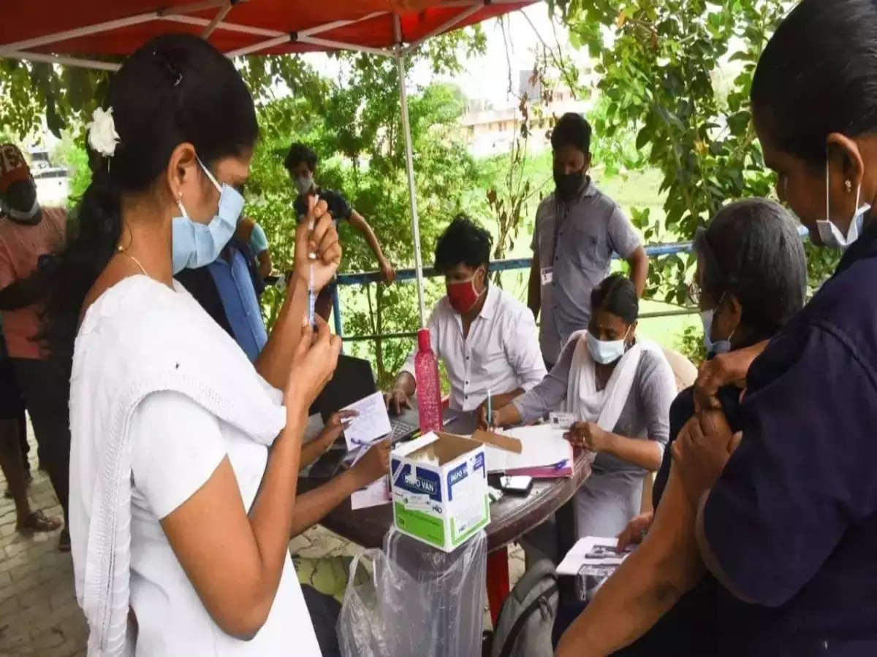
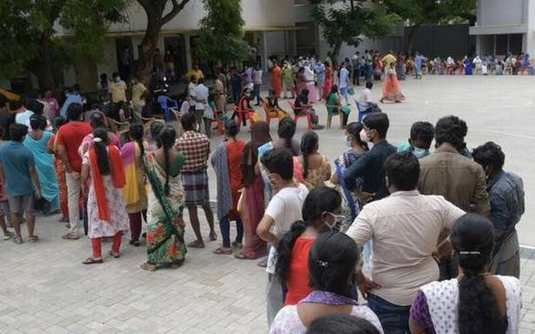
EXISTING METHODS
As we deal with the vaccine handling, we have the following existing methods.
Manual data entry
In this manual data entry process, The data of the person who is getting vaccinated is recorded manually in a register which includes the name of the person,aadhar number,age,phone/mobile number.
Disadvantages:
Time consuming Because it will take more time to write the data in the records manually
There may be loose of data in future,as the records may be get lost or gets damaged.
Checking the total number of vaccinated persons in a particular area/locality is a difficult task.

Slide 6
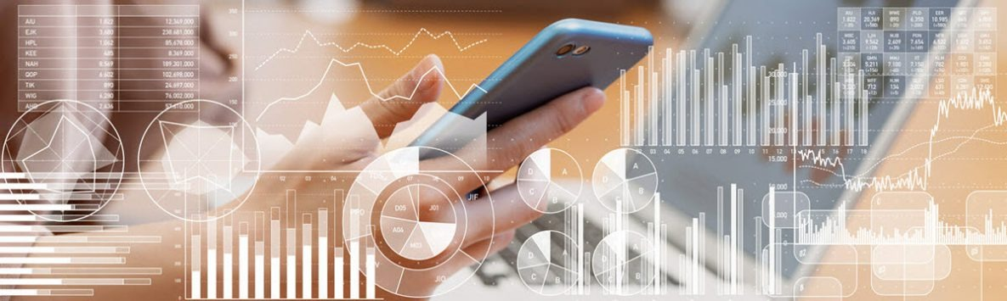
COVID-19 Vaccine Data Systems
Tracking COVID-19 vaccine distribution and administration activities requires collaboration between public and private information technology (IT) systems and integration of existing and newly developed IT systems.
The Centers for Disease Control and Prevention (CDC) — together with federal agencies, vaccine providers, jurisdictions, and state/local public health departments and tribal health facilities across the United States — use these data systems to inform decision-making regarding COVID-19 vaccination.
Disadvantages:
The vaccine data systems gives the information only about the vaccine count or the vaccine stock available at the particular vaccine center.
It doesn't provide information about the person the person who got vaccinated.

Slide 7
PROPOSED WORK
PROPOSED SYSTEM ARCHITECTURE
WELCOME PAGE
ADMIN LOGIN
OPTIONS FOR ADDING/SEARCHING DATA
Result will be Displayed based on selected option
Username
Password
Captcha
Add Data
No. of vaccines
Search
Help Desk
Exit
Add vaccines
View available

Slide 8
METHOD DESCRIPTION
Our project helps the vaccination centers to do there work fast by digital handling rather using pen and paper and handle the data in secured and easy retrieving way.
It helps the vaccine managers to take care about the vaccine centers in decreasing the people who are present there by our smart project.
By this the spread of COVID-19 will decrease and helps the volunteers to do there work fast and secured way.

Slide 9
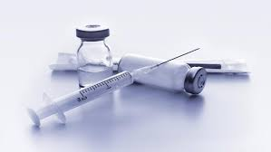
IMPLEMENTATION
1st page:
WELCOME TO
VACCINE HANDLING SYSTEM
Press any key to contine
2nd page :
USER NAME:
PASSWORD:
CAPTURE:
ENTER CAPTURE:

Slide 10
3rd page :
WELCOME
1.ADD DATA
2.NO VACCINES AVILABLE
3.SEARCH DATA
● USING AADHAR
● USING AGE OR GENDER
● USING PROFESSION
4.EXIT
PLEASE ENTER ANY OPTION TO CONTINUE

Slide 11
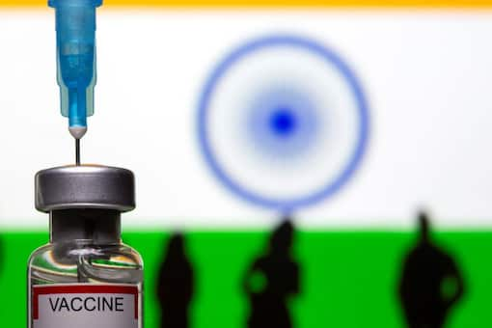
4th page:
Depending upon the option selected this page will display as add data, searching and number of vaccines available.

Slide 12
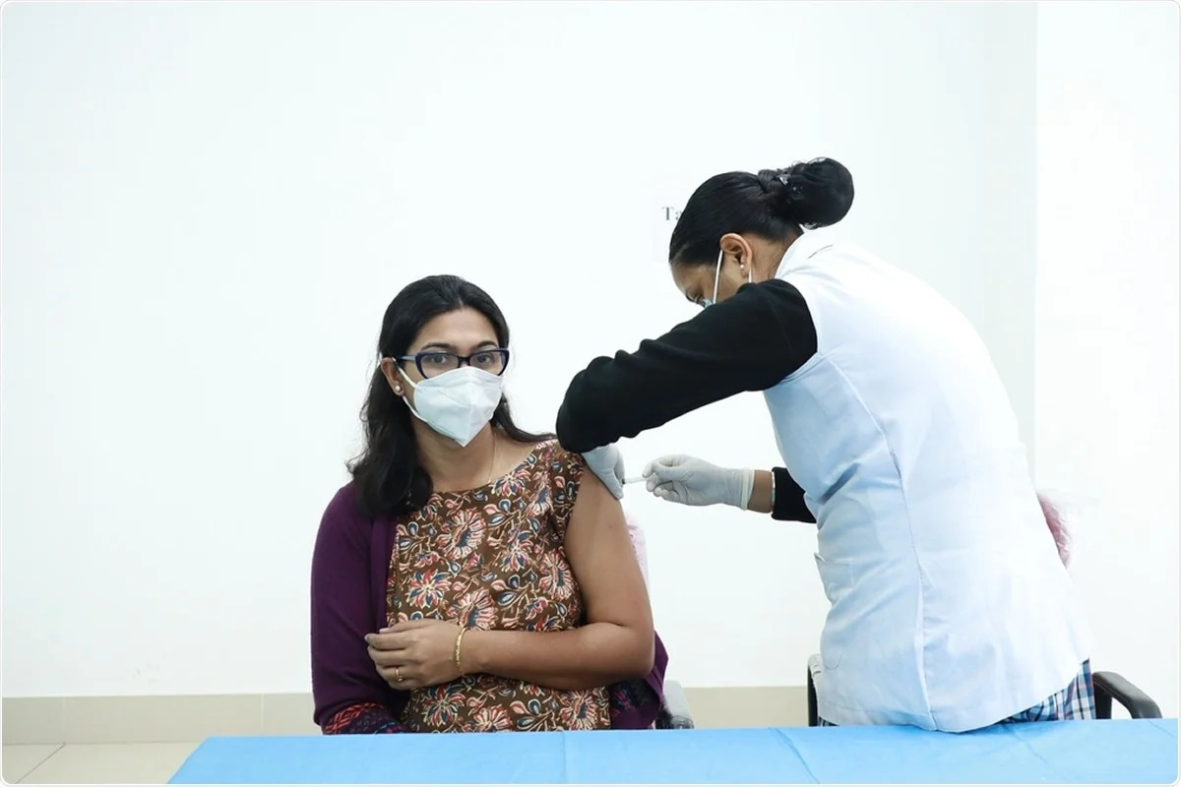
RESULT
The output of this will be displayed in the console window where the data entry and the data view is more easy and efficient.

Slide 13
THANKYOU

